Slide 1
Deploy
Microsoft Power Platform
Govern
&
Grow
1. Secure
2. Monitor
3. Alert and Action
4. Deploy
5. Nurture
6. Infrastructure
7. Support

Slide 2
Governance – Practically Applied
Secure
Monitor
Manage
Set up Azure AD conditional access Enable cross-tenant isolation Configure data loss prevention policies Define your environment strategy Manage users and their security roles Configure email exfiltration Define your data gateways strategy |  | Track user access Monitor new connectors Report on resource usage Monitor Dataverse usage Set up sharing alerts and mitigations Leverage audit logs from O365 pipeline |  | Automate policies using management connectors Leverage admin PowerShell or admin APIs for automation
Application Lifecycle Management
Managed vs Unmanaged
Learn ALM best practices
Automate ALM using Azure DevOps
Nurture and educate
Establish a Center of Excellence
Educate new makers
Foster best practices
Notes:
It requires focus on multiple aspects including security, monitoring, management, and application lifecycle management for your particular organization. In our Power Platform Governance series, we’ll show you how the Power Platform offers you capabilities in each of these different and important elements for your Power Platform deployment. The tools within the Power Platform help reduce the complexity of governing your environment and empowers admins to unlock the greatest benefits from their Power Platform assets.
Notes (09/24)
Check if it matches the guidelines, best practices
Precursor slide: personas (SOC, IT, all admins, security teams)
Visual: Emphasize that the “secure” is what were gonna focus
https://docs.microsoft.com/en-us/power-platform/guidance/adoption/admin-best-practices
Maybe remove “ALM and nurture and educate”

Slide 3


Why do you care?
Responding to bugs already fixed
Troubleshooting Environments
Integrating Changes
Deploying Apps
Building Apps
Notes:
Why do you care about ALM? Besides the piles of reports that show how it can save your company money, it really comes down to saving you time, so that you can spend more time building apps and less time dealing with moving and deploying them. Signs of poor ALM are when you are responding to your testers who are finding bugs that you’ve already fixed, or you’re troubleshooting the environments themselves because they’re out of sync, or manually integrating app changes, or even deploying the apps and their components.
Our goal is to set up systems and processes to keep you as far to the left on this chart as we can.

Slide 4
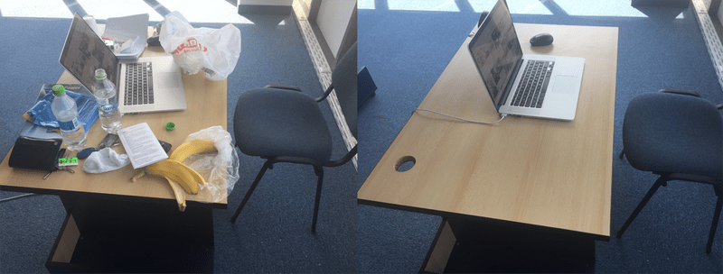
What are Solutions?
Dev
Test
Notes:
Solutions are a container for everything in your app. This doesn’t apply just to the components with Dynamics heritage. In fact, in our example here we’ll be dealing with Canvas apps and flow.
So look at this dev environment. There are a lot of components that make this solution work. To often, when it’s time to deploy your application to test the developer will replicate their application by hand in Test, moving a banana here, a sock there. Not only is this time consuming, it’s error prone. It’s easy to get components out of sync (the wrong color sock?) and then test doesn’t reflect your actual work.
Solutions allow you to move an intact, known version of the application to a new environment.

Slide 5
What are Solutions?
Is the code broken or the environment?
Was the environment already sick?
Am I missing a component?
Is a component out of date?
Dev
Test
Notes:
Solutions help remedy this. So you don’t have to answer like “Is the code broken or the environment” (I had one customer where we spent more time troubleshooting their test environment than we did on development). Or: “was the environment already sick before I deployed”. Or am I missing a component, or is a component out of date.

Slide 6


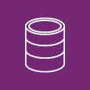
Solutions
Publisher
Solution File
App
Flow
UI Flow
Dashboard
Report
Site Map
Entity
Option Set
Email Template
Plug-in assembly
Web Resource
Environment Variable
Data Flow
Ribbon
Custom Connector
Custom control
Notes:
We use solutions to transfer configurations between environments. E.g. DEV/TEST/PROD or into source control.
The solution itself is a map or pointer back to components in your system. It could be anything here. Nearly everything in Power Platform can be added to solution.
Solutions are owned by publishers. Publishers define the ownership of the component when it’s brought into a new system. Publishers control the ability to extend the component or lock it down.

Slide 7

Solution Publisher
Solutions require a Publisher
Publisher can be associated with multiple solutions
Two default publishers are included:
CDS Default Publisher
Default Publisher for orgABC123.
Create your own Publisher - do not use one of the default publishers
Use the same publisher in all your solutions
The publisher dictates the customizations prefix and option set values
Important - When importing new assets through a managed solution – the publisher “owns” those assets
Notes:
Every solution has a publisher. The default solution has a publisher named “Default Publisher for <your organization name>”.
The publisher record contains a Prefix value. When you create new solution components, this prefix will be appended to the name. This is a quick way that allows people to understand what solution the components are part of. Having the same publisher makes it possible for you to move components between solutions as your application scope evolves.
Before you start customizing the system we recommend that you create a new publisher
When you change the value, make sure to tab to the next field. The Option Value Prefix will automatically generate a number based on the customization prefix. This number is used when you add options to option sets and provides an indicator of which solution was used to add the option.
https://technet.microsoft.com/en-us/library/dn531193.aspx#BKMK_SolutionPublisher

Slide 8



Fundamentals: Solutions
Solution
Solutions are used to package and maintain components that make up one or more Power Apps
Solutions are created and authored by a Publisher
Data Model
Entities
Attributes
Forms
Views
Charts
Relationships
Global Option Sets
User Interface
Model Apps
Canvas Apps
Web Resources
PCF Controls
Dashboards
Sitemap
Dialogs
Process/Code
Assemblies
Custom Activities
Plug-ins
Workflow Definitions
Flows
Workflow
Business Process
Rules
Other
Reports
Templates
Security Roles
FLS Profiles
System Settings (transport only)
Virtual Entities
App Modules

Slide 9
Fundamentals: Managed vs. Unmanaged
Unmanaged Solutions are to be used in development environments while you are making configuration changes to your application. Solutions are exported as unmanaged and checked into your source control system. Unmanaged solutions should be considered your source.
Managed solutions are used to deploy to any environment outside of development. This includes test, UAT, SIT, and production environments. Managed solutions should be generated by a build server and considered as a build artifact.
Notes:
Unmanaged solutions should be considered the same as source code. The contents of unmanaged solutions should be stored in source control the same way code would.
Managed solutions are used to deploy your application to test, prod or a customer environment. Like an assembly or executable, Managed solutions should be generated form source control by a build server.

Slide 10
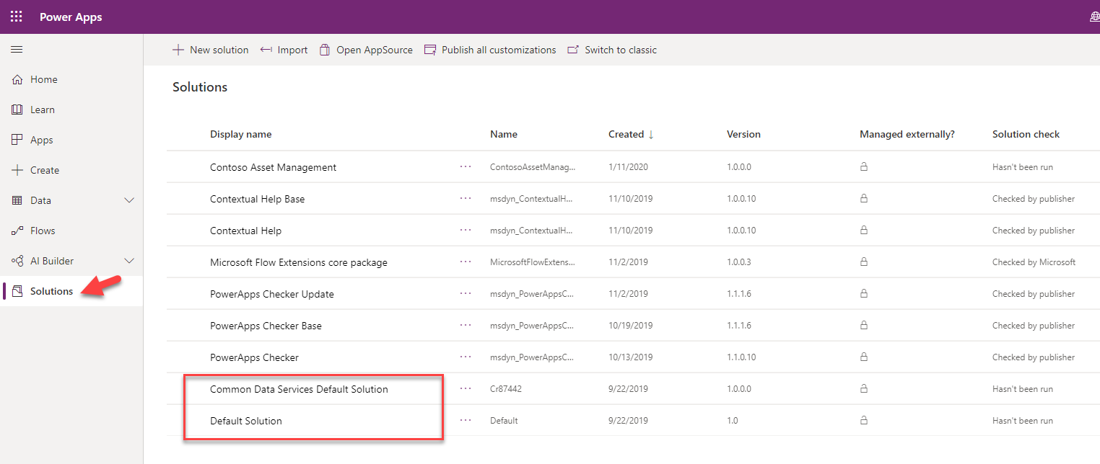
Default Solutions
Notes:
The Default Solution is automatically provided for new environments and contains a list of all the components in the system. Generally, you will not be working and making changes in the default solution, but it is useful to see all components in one place. For example, before adding any custom components in an environment, the default solution has over 1,000 components supporting the base system components.
The Common Data Service Default Solution is also automatically created in new environments but is created empty (without components). When you make changes from the PowerApps Maker portal this is the solution that will contain any of those changes by default
Creating a custom solution like Contoso Asset Management is always the recommended approach

Slide 11
Solution Components
Solution components are categorized to track the individual items associated with the solution
Component types include entities, apps (model and canvas), Power Automate flows, security components as well as developer assets
Some components are sub-components, for example forms, views, charts, and fields are all sub-component of entities
Reference data is not included as a solution component
Notes:
"When making changes or creating new components you should always start from within the custom solution you created for your project."

Slide 12
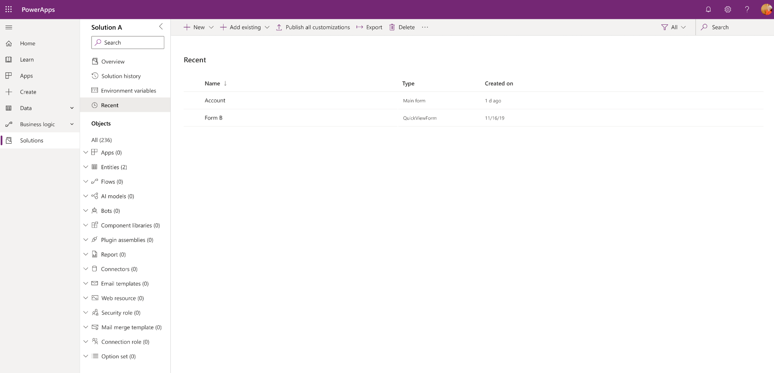
Solution Explorer Improvements (June 2020)

Slide 13
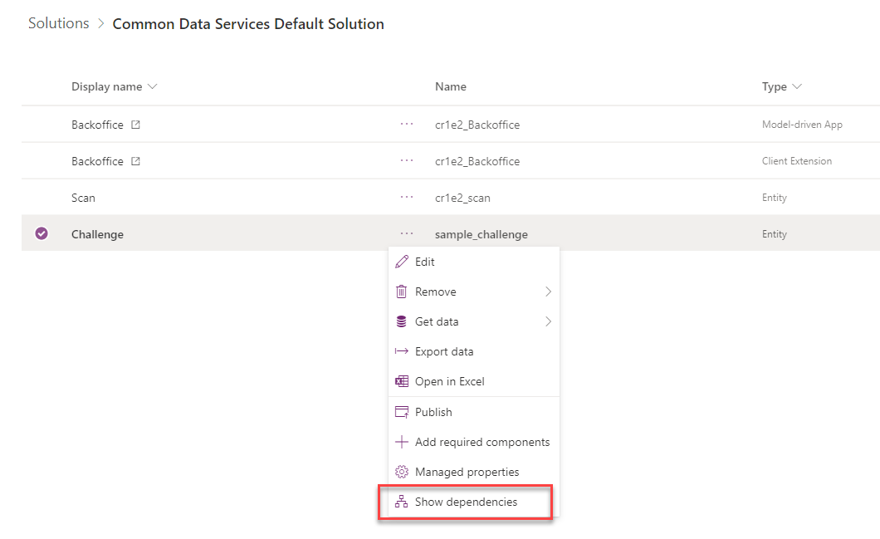
Solution Dependencies
Solution components can depend on other assets
Solution components can be required by other assets
Notes:
Solutions are made up of a set of components. These components often depend on other components to work.
For example, if you create a dashboard that has a list of Opportunity (an entity from Dynamics 365 for Sales) records on it, that dashboard component is dependent on that entity being present when the solution is installed, or it must be included in the same solution as the dashboard.
Component dependencies can be resolved by an item in the same solution, or they can be resolved by an external solution. When resolved by an external solution, that creates a solution to solution dependency. Take the example where we customized an entity that came with Dynamics 365 for Sales. Our unmanaged solution that tracked that change now has a dependency on the Dynamics 365 for Sales Solution.

Slide 14
Solution Environment Variables
Development
Test
Production
Var – From Email
Var – From Email
Var – From Email
Value – dev@contoso.com
Value – test@contoso.com
Value – prod@contoso.com
Var – Auto Approve
Var – Auto Approve
Var – Auto Approve
Default – Yes
Default – Yes
Value – No
Decimal, JSON, Text, and Two Options are supported data types
Notes:
This diagram illustrates how environment variables can be used to tailor values for each environment
Note that you can provide a default value that is used if a current value is not specified in a particular environment

Slide 15
Fundamentals: Solution Layering
Layering occurs on import of solutions
Layers describe the dependency chain of component from the root solution introducing it, through each solution that extends or changes the component’s behavior
Layers are created through extension of an existing component (taking a dependency on it) or through creation of a new component or version of a solution.
Application Behaviour
What the user sees
Unmanaged “layer”
Unmanaged Customizations
Unmanaged Solution C
Unmanaged Solution D
Managed Layers
1 per managed solution
Managed Solutions
Managed Solution B
Managed Solution A
System Layer* Dataverse Managed Layer
System Solution*
Base Dataverse entities

Slide 16
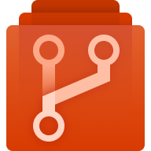
My Environment
Dev 1
Dev 2
Build
Test
Source Control
Dev 3
Managed Solution
Prod
Unmanaged Solution

Slide 17
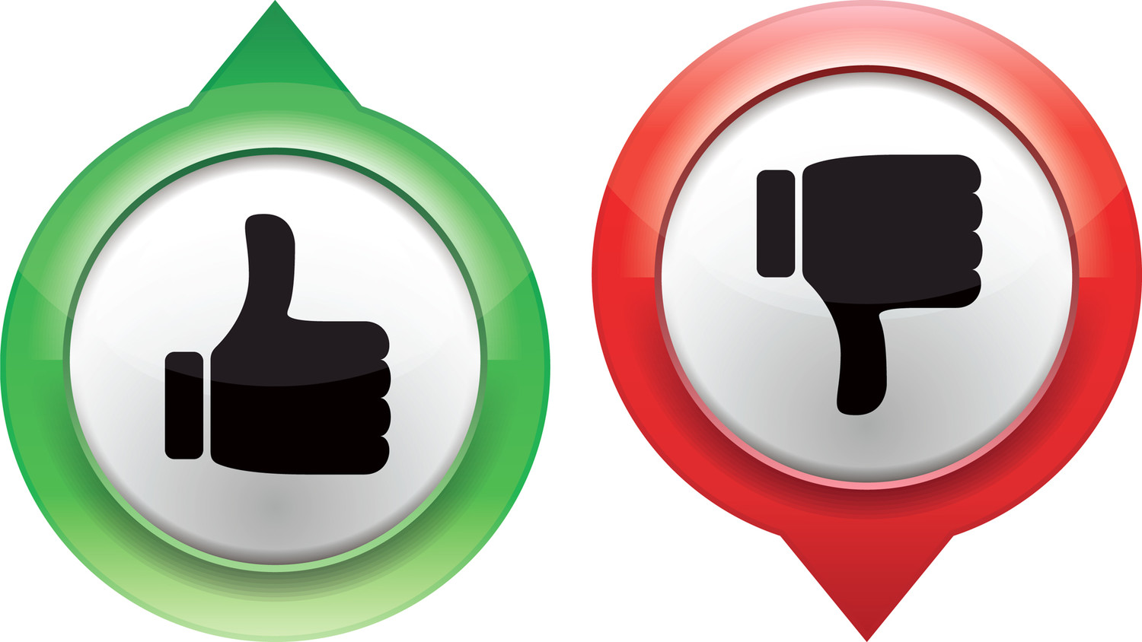
ALM Health Check
Common Publisher
Default Publisher
Solutions
Segmented
One Solution To Rule Them All
Managed Solutions
Unmanaged (or no!) Solutions
Deployment
Automated Process
Differs by Developer
Source Control
Source of Truth?
A magic environment
Disposable
Source of truth
Dev Environments?
Isolated
Shared

Slide 18
Current ALM Gaps
Difficult to maintain separation of connections
For example, app connecting to 2+ SQL or CDS Databases
Requires manual editing
Flows and Apps lose connections
Re-adding is manual + creates unmanaged layer
Deleting a managed solution doesn’t rollback Canvas apps (deletes it)
Flows created in solution not shown in list (access via solution)
Build Tools: Must import Canvas Apps using Generic Connection
https://docs.microsoft.com/en-us/powerapps/maker/common-data-service/solutions-overview#known-limitations

Slide 19
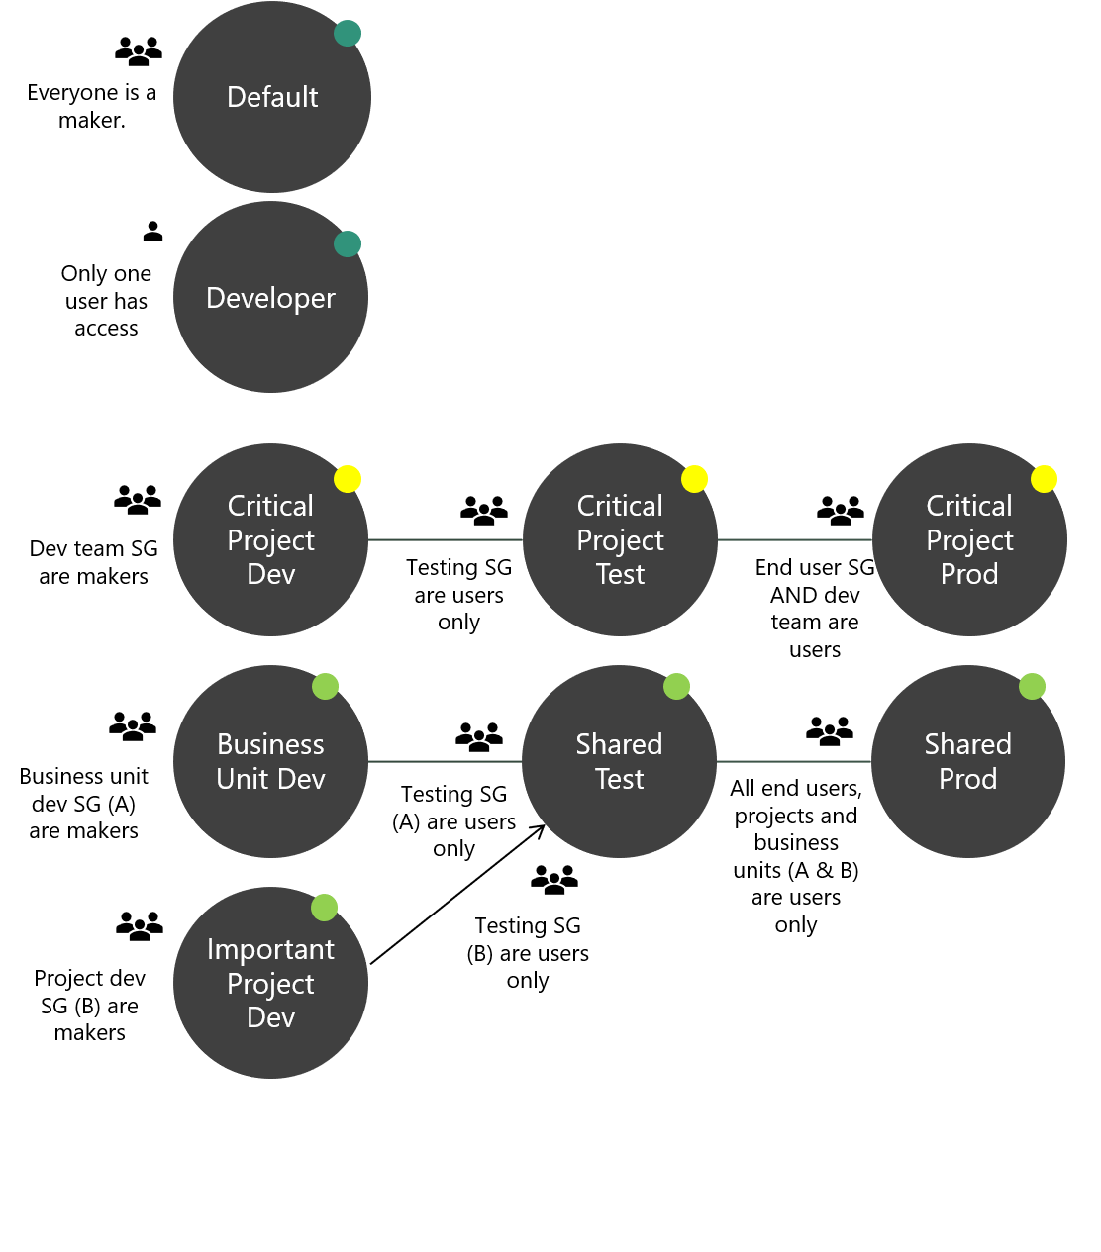
Environment Strategy
Multiple short-lifecycle environments for small-team dev or training
Dedicated environments for critical or large project
Multiple business unit dev environments using shared test.
Notes:
This is one example of an environment strategy. Single environments for individual developers, training and proofs of concept.
Dedicated environment sets for critical, or ERP-scale projects.
Or environment sets for business units that use multiple project-based dev environments, that come together in a central test and prod environment.

Slide 20

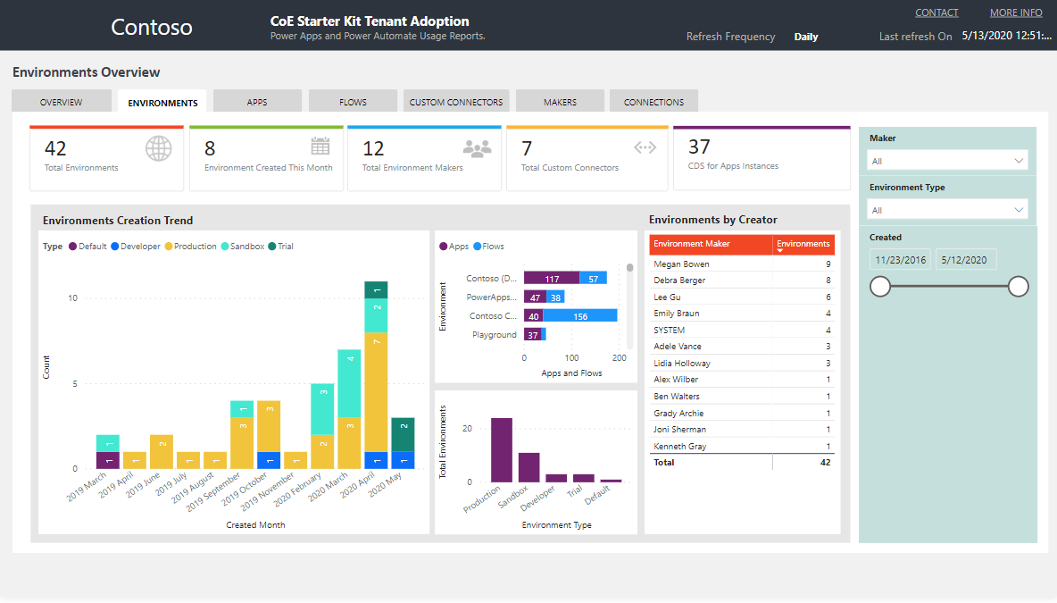


CoE Toolkit – Monitor Environments
Monitor Environment creation and usage.
Easily identify environment owners
Filter by environment type (Production, Sandbox, Developer, Trial)
https://aka.ms/coestarterkit
Notes:
The CoE toolkit provides an easy way to monitor environments across the organization. See usage of environments, identify owners and filter by type.

Slide 21
DevOps – what’s the value?
The greatest value add from implementing DevOps is gained through the automation of manual processes allowing for the continuous delivery of value to customers.
Automate build and deploy
Increased speed to market
Faster mean time to resolution

Slide 22
Power Platform Build Tools ALM Powered by Azure DevOps
Initiate
Build
Release
Getting started, faster
Build and Test Automation
Automated, Predictive, Repeatable
Create
Repo
Export
Unmanaged
Unpack
Solution
Check in
to source
Run Unit Test
Run
Power Apps
Checker
Export
Solution
Unpack to
Repo
Run Unit Test
Pack Solution
Run Solution
Checker
Run
Integration
Test
Import as
unmanaged
Increment
Version
Export
Managed
Provision
Environment
Deploy
Dependencies
Pack Source
Code from
Repo
Import
Solution
Initial Build Pipeline instantiates pristine Development Environment daily, exports solutions and unpack to Source Control
Build Pipeline Automates manual steps.
No more upload to Solution checker and manually export solution, unpack and push to repo
Automated Release Pipeline removes manual steps. Weekly, daily or hourly releases becomes the new standard
Powered by Azure DevOps and Git

Slide 23
From Environment Centric to Source Control
Install Power Platform Build Tools
Create a Build pipeline to Export from Dev
Create a Build Pipeline to generate build artifact
Create a Release Pipeline to Deploy to production

Slide 24
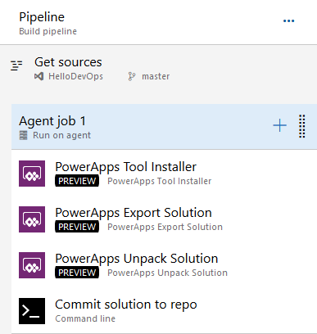
Build Pipeline: Export Solution from Dev
Tools Installer
Export Solution
Unpack Solution
Commit Solution to repo

Slide 25
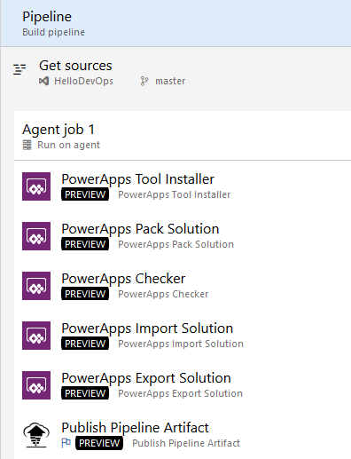
Build Pipeline: Build Managed Solution
Tools Installer
Pack Solution
PowerApps Checker
Import Unmanaged Solution
Export Managed Solution
Publish Pipeline Artifact

Slide 26
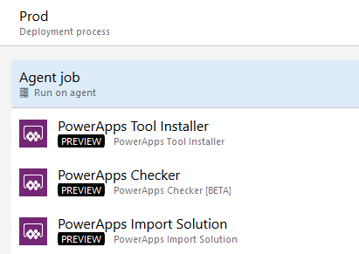
Release Pipeline: Deploy to Production
Install Tools
Checker Solution
Import Solution

Slide 27

Demo
From Environment to Source Control

Slide 28

But what about my code?
How can my code participate in the same Application Lifecycle

Slide 29
CLI Option 1
Build the plugin
Register plugin
Add to solution
Use existing pipelines for CI/CD

Slide 30
Demo
Use CLI to build your plugin and add it to your solution
pac plugin init
Register the plugin using plugin registration tool
Add the plugin to your solution
Use regular build pipeline to move solution to source control and deploy to downstream environments

Slide 31
CLI Option 2
Build the Plugin
Register the Plugin
(Clone) Solution to Source
Add to Solution
Add Reference to Dataverse Proj
Modify Build Pipeline to use the new Build Model

Slide 32
Demo
Use Clone to pull solution to source and add your plugin
pac plugin init
Register the plugin using plugin registration tool
Add the plugin to your solution
pac auth create --url <ENVIRONMENT URL>
pac solution clone –name <SOLUTION>
pac solution add-reference –path <path to plugin>
Msbuild /restore
Update Build pipeline

Slide 33
What’s coming for PowerApps Build Tools
Environments as Azure DevOps variable
Support for both Dynamics 365 CE & Dataverse Environments
Service Principals Auth
Async Solution Import
AppSource Deployment Task

Slide 34
Documentation refresh and deprecation of old assets
DevOps: Why should you care
What is Azure DevOps: Getting Started
Zero to Full Source control: From Environment centric to Source centric
PowerApps DevOps Part I: Build your first Pipeline
PowerApps DevOps Part II: Automate your releases
PowerApps DevOps Part III: Integrate Code in your build and release Pipes
Packaging your app: Working with Solutions
Manage: Work with Environments and manage your apps

Slide 35
Resources
PowerApps Build Tools
https://aka.ms/ppalmlab
PowerApps Build Tools multi-stage YAML Pipelines
PowerApps Documentation -> I’m a developer -> Package and distribute apps/extension
PowerApps Blog – ALM
Community:
Marc’s YouTube channel
Wael’s blog

Slide 36
Key Takeaways
Development is moving from environment centric to source control centric, Just like every other dev project you’ve ever been associated with
Unmanaged Solutions are for development only. Only Managed Solutions are deployed to non-dev orgs
Don’t wait to automate!
Build automation starts before any customizations or code is developed

Slide 37
Next Steps

Slide 38
Module Review
Work with makers early to prepare for how apps and flows will be deployed
Using Solutions to deploy offers the best application lifecycle management experience
Notes:
Start Time xx:xx / Length: 2 minutes
Review the objectives for this module.
Ask participants to use the Text tool to write on the screen if they had any questions about the module.

Slide 39
Deployment scenarios
Supporting Power Users
Centrally Managed Apps
Helping power users share the apps and flows they built
Typically single environment
Export and import of individual components for backup/restore
Could add-on or extend some centrally managed assets
More formal process for rolling out updates
Often involves multiple environments e.g. dev/test/prod
Solutions are used to allow export/import of a set of assets
Could include installation and configuration of App Source solutions

Slide 40
High level deployment tasks
Coordinate with makers
Export from development
Import to test
Setup Connections
Associate Security Roles
Share to make available
Repeat for production
Notes:
Process shows for test and is repeated for production using the same solution that was exported from development

Slide 41
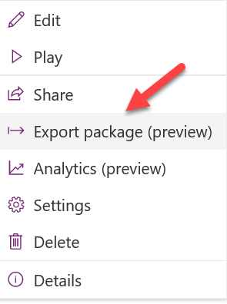
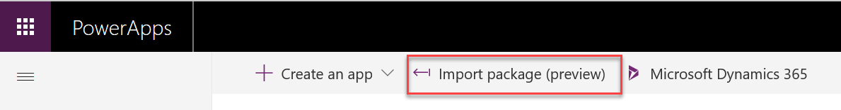
Working with individual resources
Canvas apps and flows can individually be exported and imported to move between environments
Environment A
Environment B
Notes:
Moving individual resources is the preferred approach only when Dataverse is not present in the environments to allow use of solutions.
Exporting an individual resource can also be used for application backup purposes

Slide 42
Solutions Overview
Solutions are a container to track the changes you make including apps, flows and Dataverse components
Solutions are how you transport and install changes to target environments
Microsoft Dynamics 365 apps are installed using solutions
3rd party apps provided by Independent Software Vendors (ISVs) also use solutions
Development
Test
Production
Notes:
Solutions are containers that track and manage customizations in a Dataverse environment
If you have multiple environments, each would have their own set of solutions. Solutions can include entity metadata, forms, views, business rules, processes definitions and other assets required to run the app; including components created by developers like scripts or compiled code.
when you have a Dynamics 365 application like Sales or Service those are installed using the same solution framework. 3rd party ISVs also ship their products using solutions

Slide 43
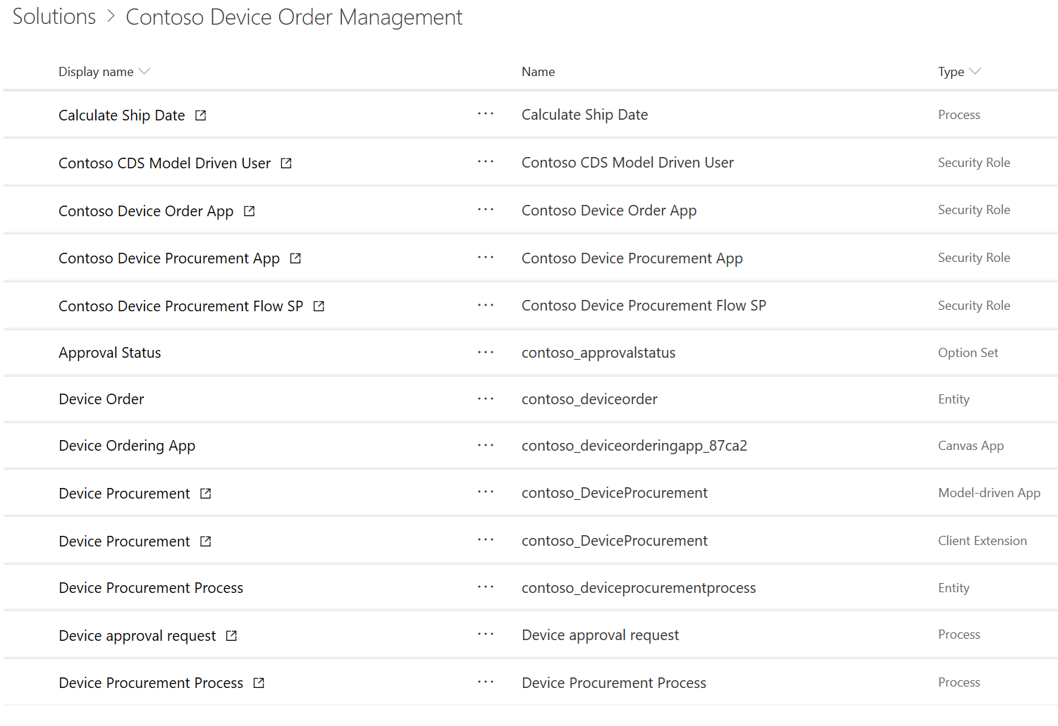
Contoso Device Ordering Solution Example
Solution – Device Ordering
Apps
Data (Entities)
Processes
Device Ordering
Device Order
Order Approval Flow
Device Procurement
Device Procurement Process
Security Roles
Device Ordering App role
Device Procurement App role
Device Procurement Flow role

Slide 44
Types of Solutions
Unmanaged
Managed
Used during development
Used to transport to other development environments
Used to distribute to non-development environments

Slide 45
Application Lifecycle with Solutions
Development Environment
Test Environment
Production Environment
Data Model
Forms
Device Ordering
Solution
Device Ordering Solution
Device Ordering Solution
Roles
…
Export as unmanaged
Export as managed
Import managed
Import managed
Notes:
It’s important to note that you should always have secured an unmanaged copy of the solution in addition to the managed copy. The unmanaged is needed if you have to re-create the development environment in the future.

Slide 46
Environment with Multiple Solutions
Innovation Challenges
Employee Referrals
Employee Kudos
Test Environment
Device Ordering
Contoso Shared Components
CDM/System Entities

Slide 47
Solution Tooling
PowerApps Build Tools
Configuration Migration
Solution Packager
Package Deployer
Dataverse Web API
Solution Checker
Notes:
https://github.com/WaelHamze/dyn365-ce-vsts-tasks

Slide 48
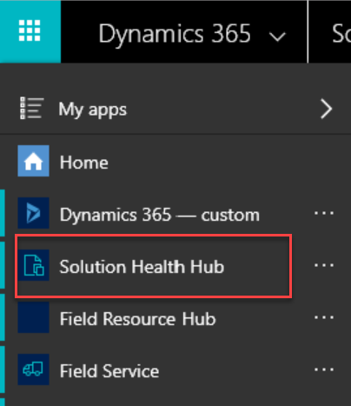
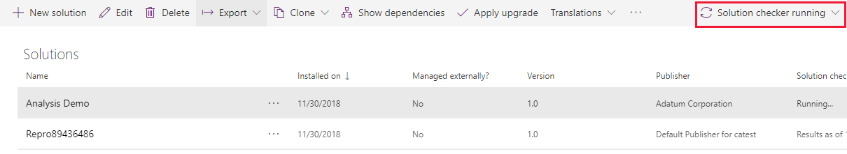
PowerApps Solution Checker/Health Hub
Solution Checker does static checks to identify performance, stability, and reliability issues with Solutions
Solution Health Hub runs rules to validate the configuration of an environment
Notes:
More details here https://docs.microsoft.com/en-us/powerapps/maker/common-data-service/use-powerapps-checker
Makers should use Solution Checker to ensure their solution is ready for prime time
Administrators can check status of Solution Checker to ensure promoting solutions to productions that don’t have issues
Solution Health Hub is a model-driven app that allows creating, viewing and running health rules in an environment
Administrators can use and define Health Hub rules to ensure the solution is configured properly in the target environment

Slide 49
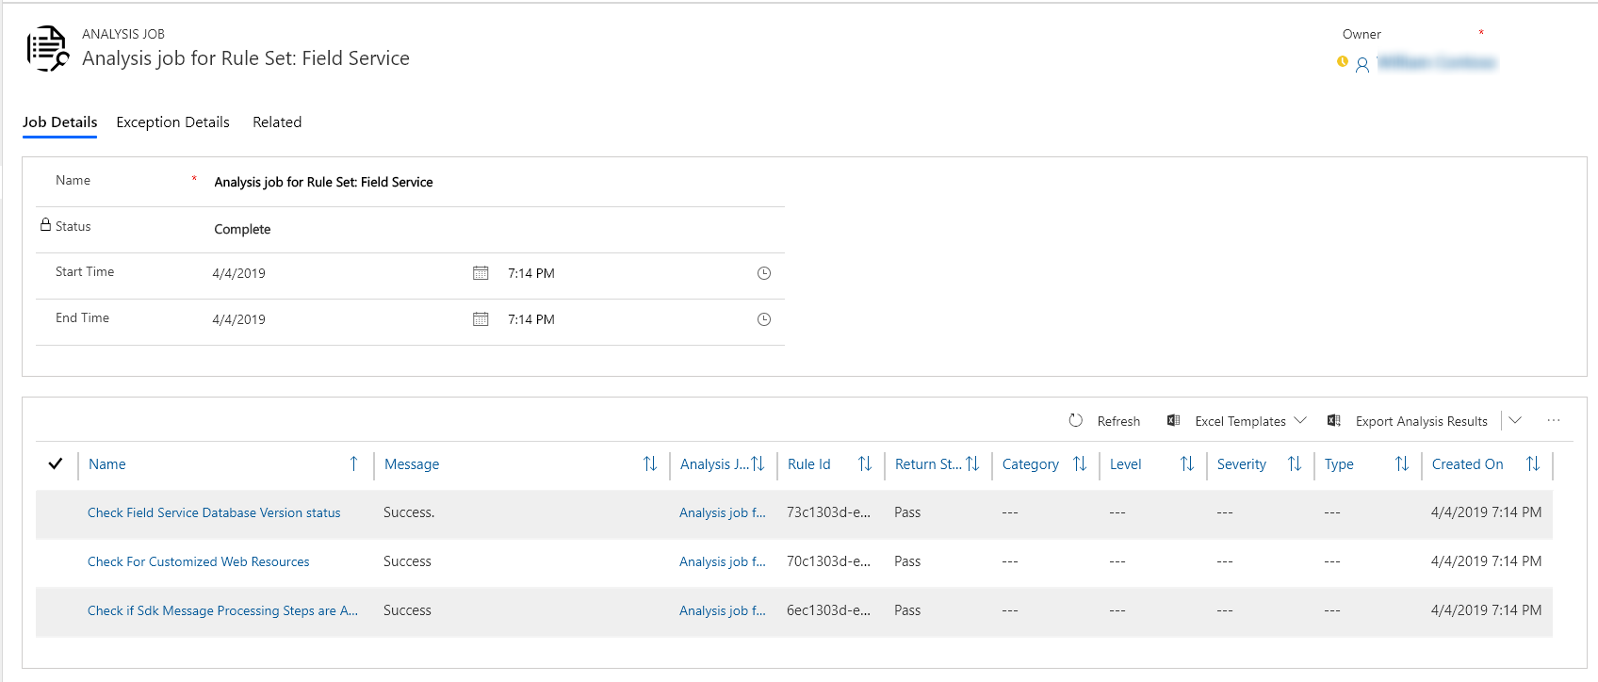
Solution Health Hub
Rules are used to validate configuration
Resolve problems by pre-defined corrective actions
Notes:
More on Health Hub here - https://docs.microsoft.com/en-us/dynamics365/customer-engagement/admin/solution-health-hub

Slide 50
Environment Variables
Allows values that differ between environments to be dynamically replaced instead of hard coded
Defined by makers as part of a Solution
Can be used by flows and via API for initial release
Solution can contain default values
After import to target environment, blank values must be established
Notes:
Environment variables are solution components
Upon import, portal will prompt that there are missing values and administrator can update
After initial update to change or see values admin goes to default solution and looks and/modifies the variable value

Slide 51
Example – Environment Variables
Development
Test
Production
Var – From Email
Var – From Email
Var – From Email
Value – dev@contoso.com
Value – test@contoso.com
Value – prod@contoso.com
Var – Auto Approve
Var – Auto Approve
Var – Auto Approve
Default – Yes
Default – Yes
Value – No
Decimal, JSON, Text, and Two Options are supported data types
Notes:
This diagram illustrates how environment variables can be used to tailor values for each environment
Note that you can provide a default value that is used if a current value is not specified in a particular environment

Slide 52
Assigning Security Roles
Manual association
Using Azure AD Groups
User added to environment
User optionally added to team
Security role assigned to user or team
Team created in Dataverse and associated with Azure AD Group
Security roles assigned to Dataverse Team
Users added to Azure AD Group automatically added to Dataverse Team
Notes:
Both Office Group and Security Groups are supported – correct type must be chosen when configuring the Dataverse team

Slide 53
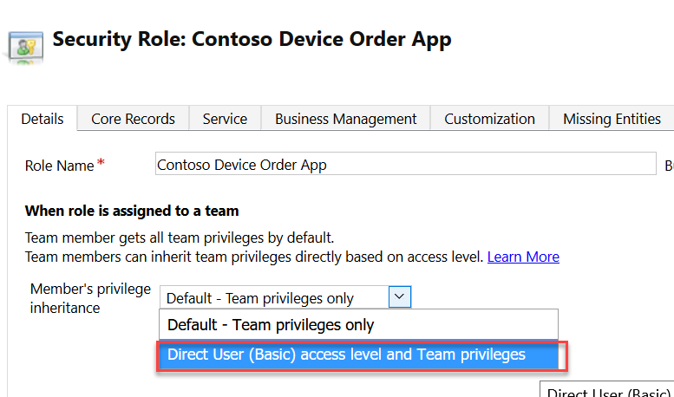
Direct User Team Privileges
Changing to Direct User treats privileges as if they were assigned directly to the user
Notes:
Security Roles used need to be configured to have Direct User privileges if users are to own records directly
Team privileges only: User is granted these privileges as member of the team. For team members who do not have user privileges of their own, they can only create records with the team as the owner and they have access to records owned by the Team when Basic access level for Create and Read were given.
Direct User privileges: User is granted these privileges directly when a security role is assigned to the user. User can create and has access to records created/owned by the user when Basic access level for Create and Read were given.

Slide 54
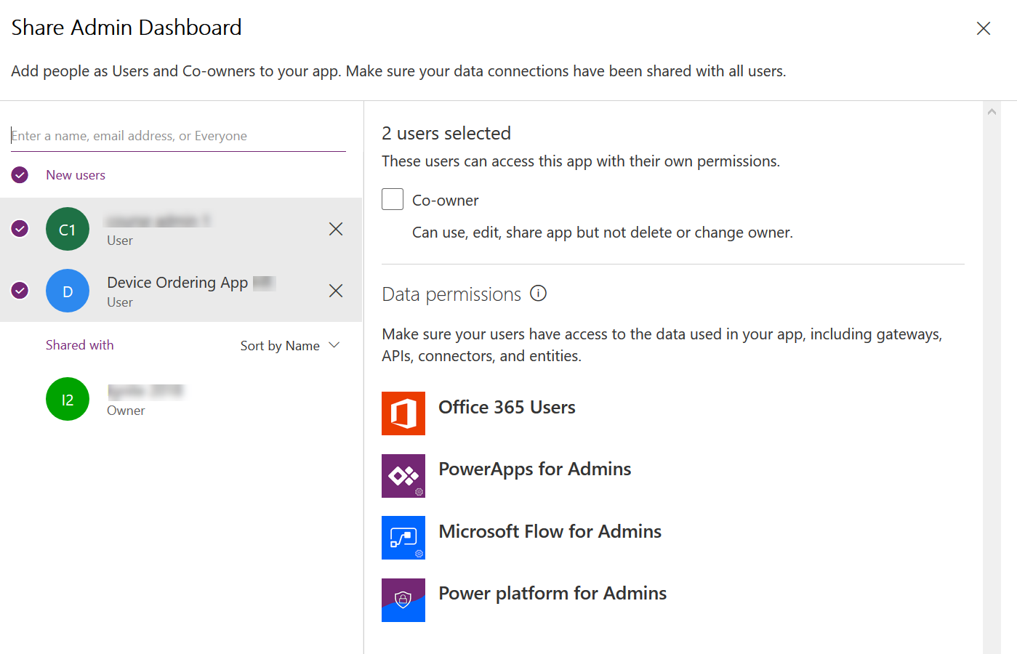
Sharing a canvas app
Notes:
Can share with a User directly or with a Azure AD Group
Must already have access to Dataverse Data via security role assignment to Azure AD Group or directly to the user

Slide 55
Flow Connector User Security Context
Instant Flows
Scheduled Flows
Automated Flows
Co-Owner or Run-Only
Allow using existing connection or require them to use their own
Can choose for each connection used
Settings are for all Run-only users, you can’t individually set
Co-Owner
Uses existing connection, any owner can change
Co-Owner
Uses existing connection, any owner can change
Notes:
When configuring instant flows if you choose to use existing account it generally shouldn’t be an admin account otherwise it could

Slide 56
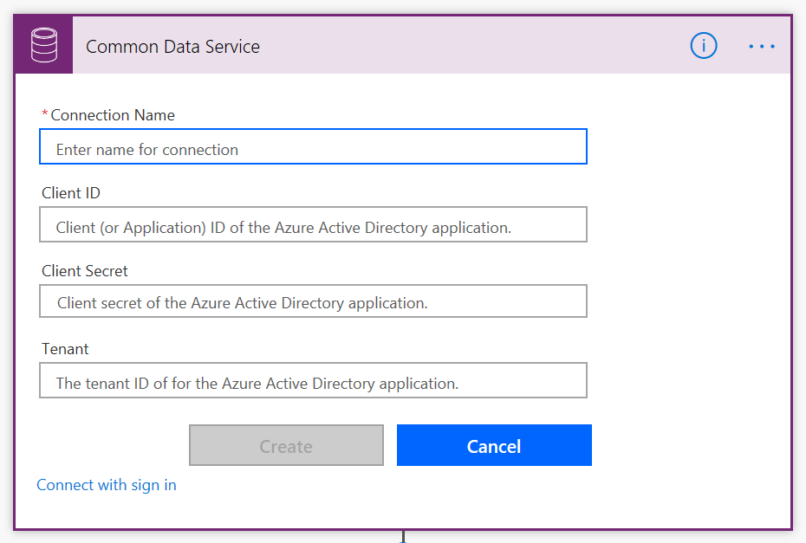
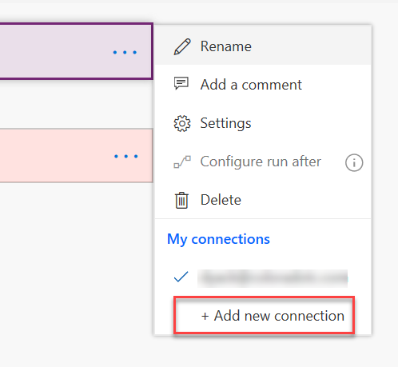
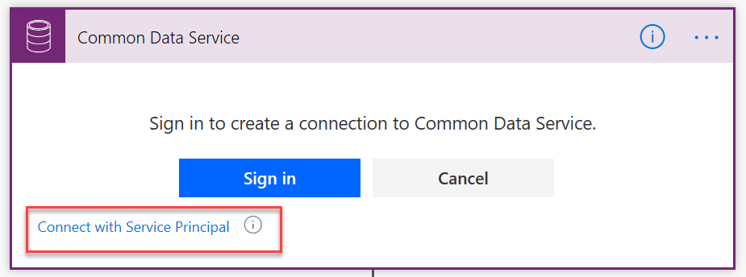
Using a service principal with Dataverse Connector
By default, sign-in uses interactive user that requires an appropriate license, and executes in the user's context
Using a service principal allows actions to be executed using a Dataverse App User context

Slide 57
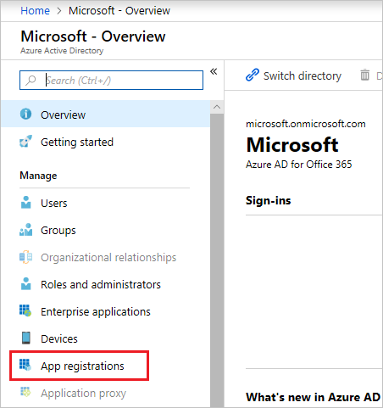
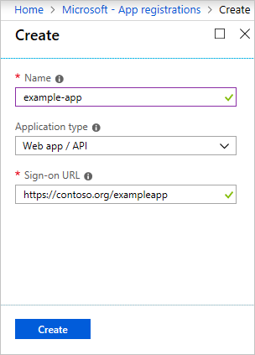
Preparing a service principal
portal.azure.com
Create a Dataverse Security Role
Create a Dataverse App User
Needs base permissions, currently Environment Maker or similar
Needs permissions to anything your flow will do
Minimal permissions are best
In the Classic web app
Settings - >Users
Set view to App User
Set form to App User
Use Azure AD App Info
Assign security role after creation

Slide 58
Session Resources: Documentation
Solution Checker Documentation:
https://docs.microsoft.com/en-us/powerapps/maker/common-data-service/use-powerapps-checker
PowerApps Blog:
https://powerapps.microsoft.com/blog/
Working with Solutions in PowerApps
https://docs.microsoft.com/en-us/powerapps/maker/common-data-service/solutions-overview
Introduction to Solutions
https://docs.microsoft.com/en-us/dynamics365/customer-engagement/developer/introduction-solutions
Solution Lifecycle Management Whitepaper (Phil Hand)
https://www.microsoft.com/en-us/download/details.aspx?id=57777
Notes:
This slide is required. Do NOT delete. This slide is recommended as a final slide to recap additional resources.
Use this slide to share additional available content that attendees can leverage after the event. In this section you can call out whitepapers, websites, communities, etc. that might be useful for the learner.

Slide 59
Session Resources: Tools
CoreTools (including Solution Packager) of SDK:
https://www.nuget.org/packages/Microsoft.CrmSdk.CoreTools
Powershell modules of the SDK:
https://docs.microsoft.com/en-us/powershell/dynamics365/customer-engagement/overview?view=dynamics365ce-ps
Azure DevOps CI/CD tools by MVP Wael Hamze
https://marketplace.visualstudio.com/items?itemName=WaelHamze.xrm-ci-framework-build-tasks
Microsoft.Xrm.Data.Powershell modules
https://github.com/seanmcne/Microsoft.Xrm.Data.PowerShell
Notes:
This slide is required. Do NOT delete. This slide is recommended as a final slide to recap additional resources.
Use this slide to share additional available content that attendees can leverage after the event. In this section you can call out whitepapers, websites, communities, etc. that might be useful for the learner.

Slide 60
Videos
Zero to full source control of a model-driven PowerApp using spkl (Marc Schweigert)
https://www.youtube.com/watch?v=Vvl1fYt8To0
Productive web resource development for model-driven PowerApps (Marc Schweigert)
https://www.youtube.com/watch?v=Vvl1fYt8To0
Build and deployment automation of a model-driven PowerApp using VSTS (Marc Schweigert)
https://www.youtube.com/watch?v=R18HOh2j40k
Notes:
This slide is required. Do NOT delete. This slide is recommended as a final slide to recap additional resources.
Use this slide to share additional available content that attendees can leverage after the event. In this section you can call out whitepapers, websites, communities, etc. that might be useful for the learner.

